Slide 1

LG Dealer Day | 03 May 2019
Craig Bailey | XEN
Notes:
Replace image placeholder: Click on the image -> Click on ‘Replace image’ -> Choose your image.

Slide 2

Craig Bailey
Technical Director | XEN
Loves testing digital marketing stuff
Founder of XEN | Digital Agency | Since 2010
Helping businesses generate leads
Worked with LG Solar
Notes:
Replace image placeholder: Click on the image -> Click on ‘Replace image’ -> Choose your image.

Slide 3
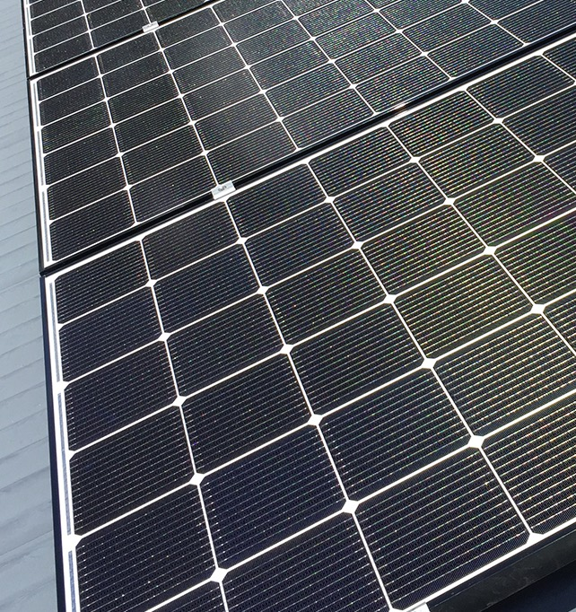
Agenda
15 mins + Questions
Changes in marketing and sales
What’s working, what’s not working
Challenges & Opportunities
Key items to put in place
Notes:
Replace image placeholder: Click on the image -> Click on ‘Replace image’ -> Choose your image.

Slide 4
www.xensolar.com.au/lg-dealers
https://www.xensolar.com.au/lg-dealers/dealer-day-2019

Slide 5
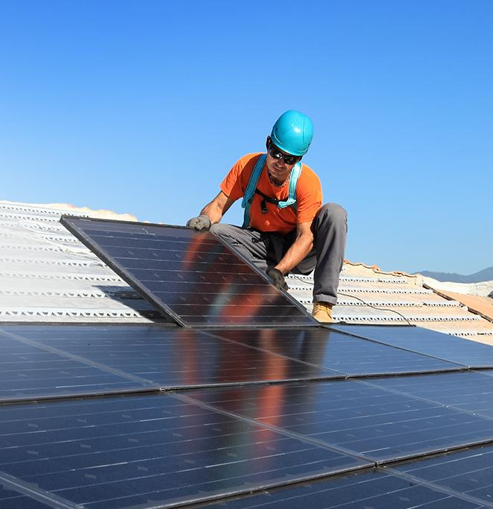
Digital
Marketing
Landscape
Changes in marketing and sales
Getting more competitive
Seasonal and political factors
What was working is now less effective
Notes:
Replace image placeholder: Click on the image -> Click on ‘Replace image’ -> Choose your image.

Slide 6

Why it’s less effective
Challenges & Opportunities
Competitors copy marketing techniques, diluting the market
Aggressive telemarketing (and scams)
Door knocking
Notes:
Replace image placeholder: Click on the image -> Click on ‘Replace image’ -> Choose your image.

Slide 7
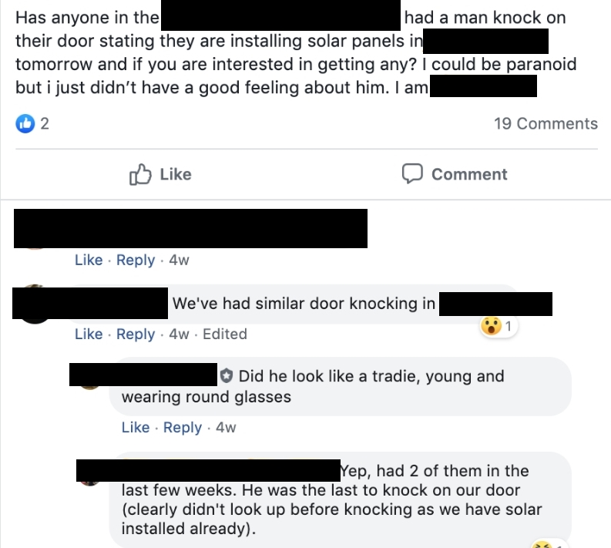
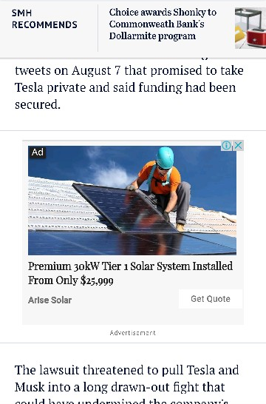
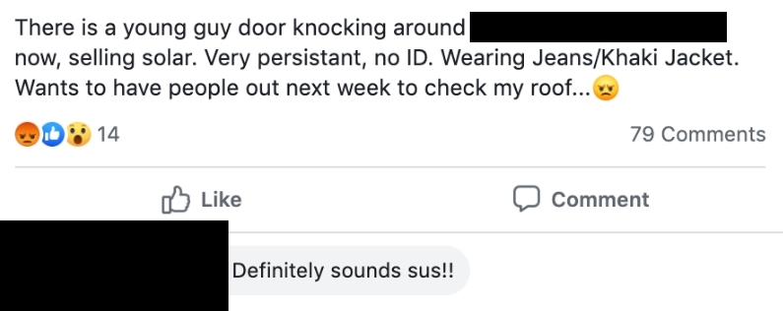
Notes:
Replace image placeholder: Click on the image -> Click on ‘Replace image’ -> Choose your image.

Slide 8
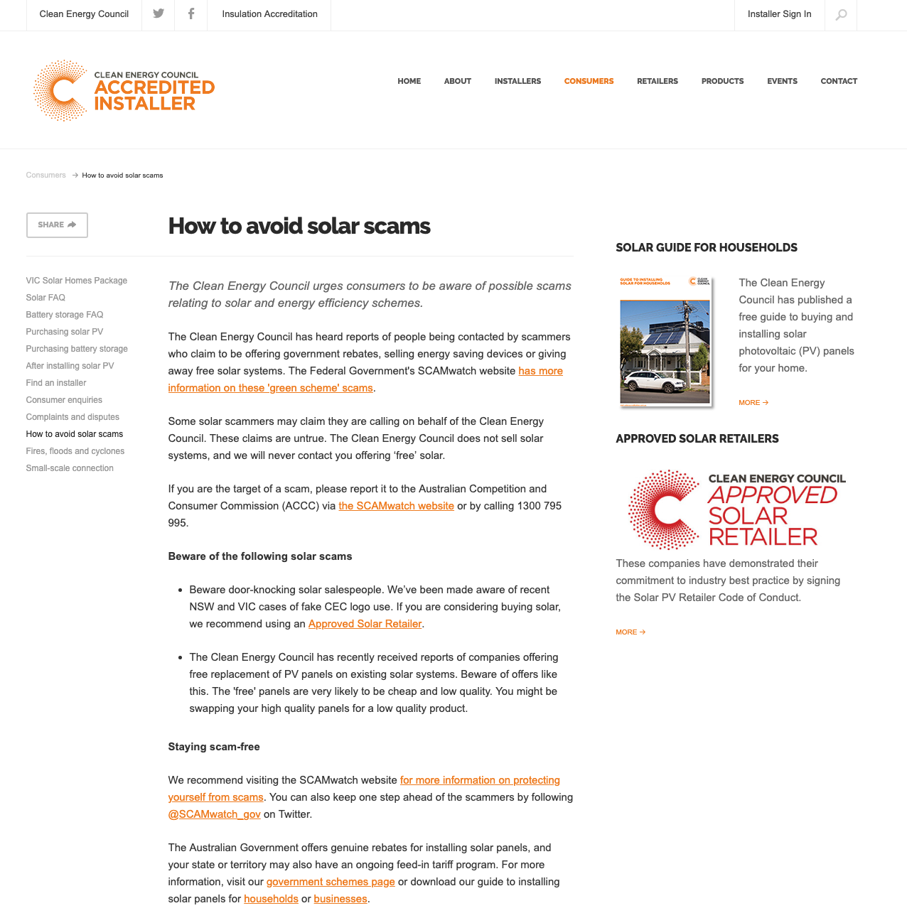

Slide 9

How Can We Respond?
Challenges & Opportunities
The purpose of marketing:
Lead Generation is changing
Credibility is becoming more important
Notes:
Replace image placeholder: Click on the image -> Click on ‘Replace image’ -> Choose your image.

Slide 10
First, let’s talk about why credibility is so important

Slide 11
CUSTOMER JOURNEY
Customers usually go through a process before they purchase
Research
Consider
Decide
Refer
What is my problem?
What are the possible solutions?
Who should I purchase from?
Who will I boast about this to?
Full video on this available here: https://www.xensolar.com.au/lg-dealers/dealer-day-2018-videos

Slide 12
CUSTOMER JOURNEY
Content and Channel matching
Research
Consider
Decide
Refer
Blog post & Ebooks
Facebook Ads
FAQs & Product
Email & Remarketing
Testimonials & Quotes
Social, Google AdWords
Reviews
Google My Business
Full video on this available here: https://www.xensolar.com.au/lg-dealers/dealer-day-2018-videos

Slide 13

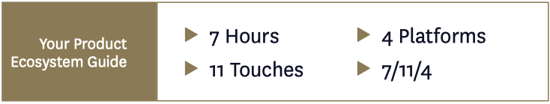
Google ZMOT
Zero Moment of Truth (back in 2011)
That was in 2011...
Source: Google

Slide 14
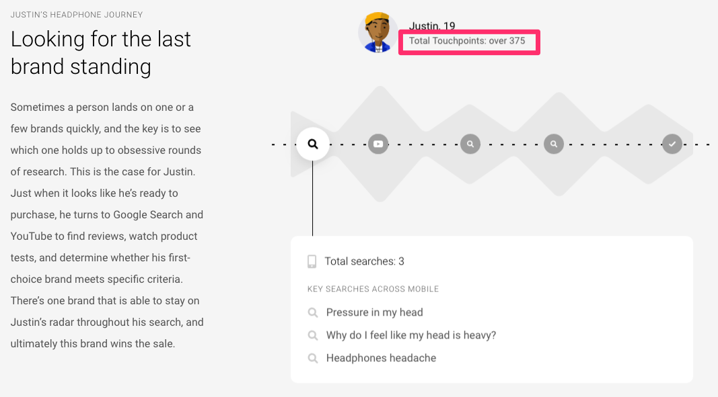
Google Research Study
In 2018, consumers visit many sites, many times, before deciding (or even making contact)
Source: Google

Slide 15
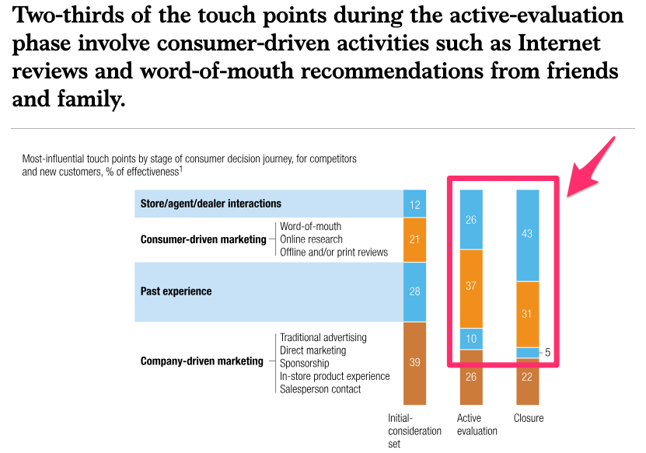
McKinsey Study
Consumers across a range of services and industries
Source: McKinsey & Company

Slide 16

Credibility
Key items to put in place
Reviews and testimonials
Highlighting installs, photos and videos on social
Instagram as a showcase
Time in business (eg 10+ years)
Highlighting quality - products and services
Mobile friendly
Fast site
Up to date social channels
Notes:
Replace image placeholder: Click on the image -> Click on ‘Replace image’ -> Choose your image.

Slide 17
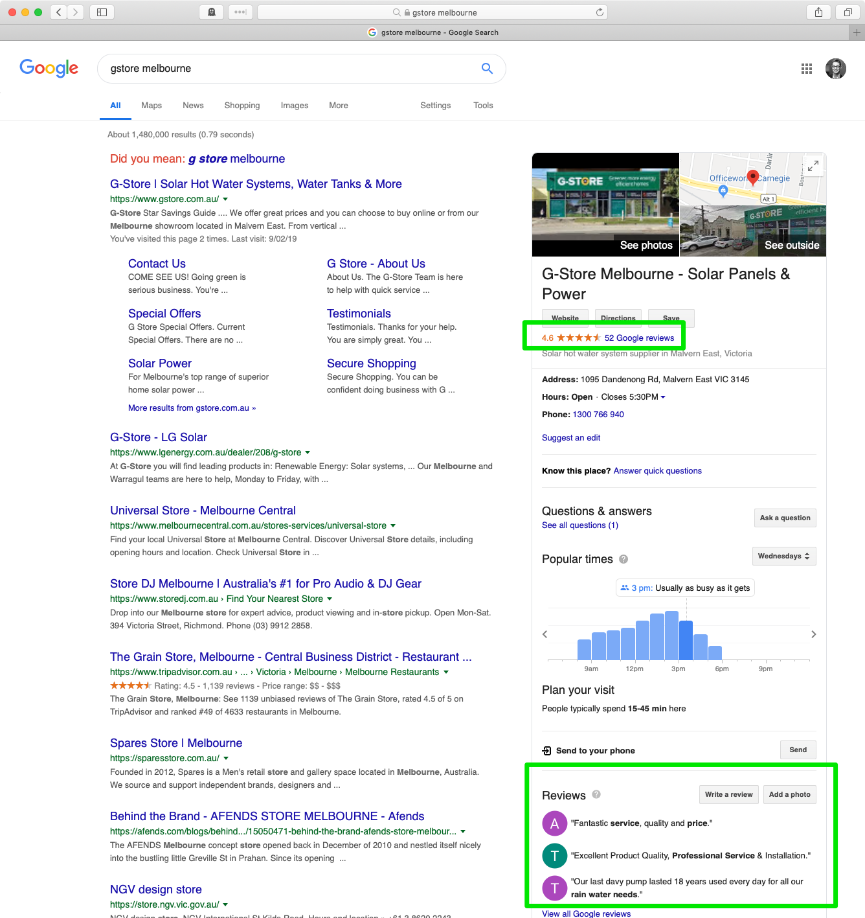
Google My
Business
Listing
Example brand search
Gives your business a good presence in search results
Reviews are important
Notes:
Replace image placeholder: Click on the image -> Click on ‘Replace image’ -> Choose your image.

Slide 18
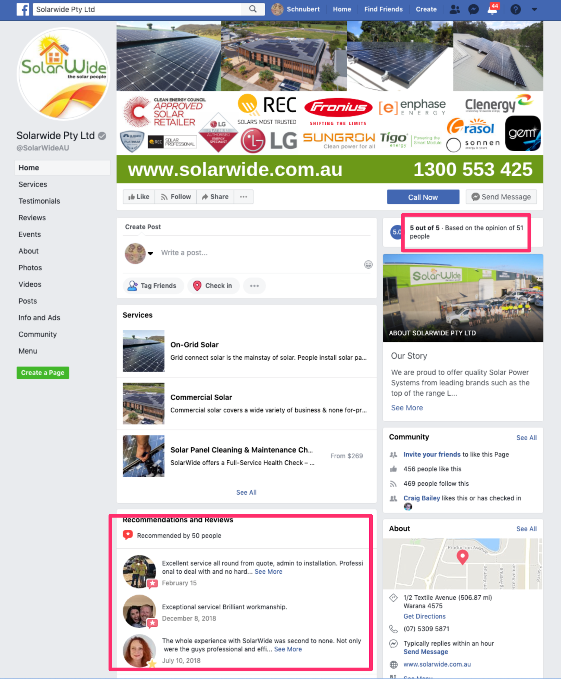

Slide 19
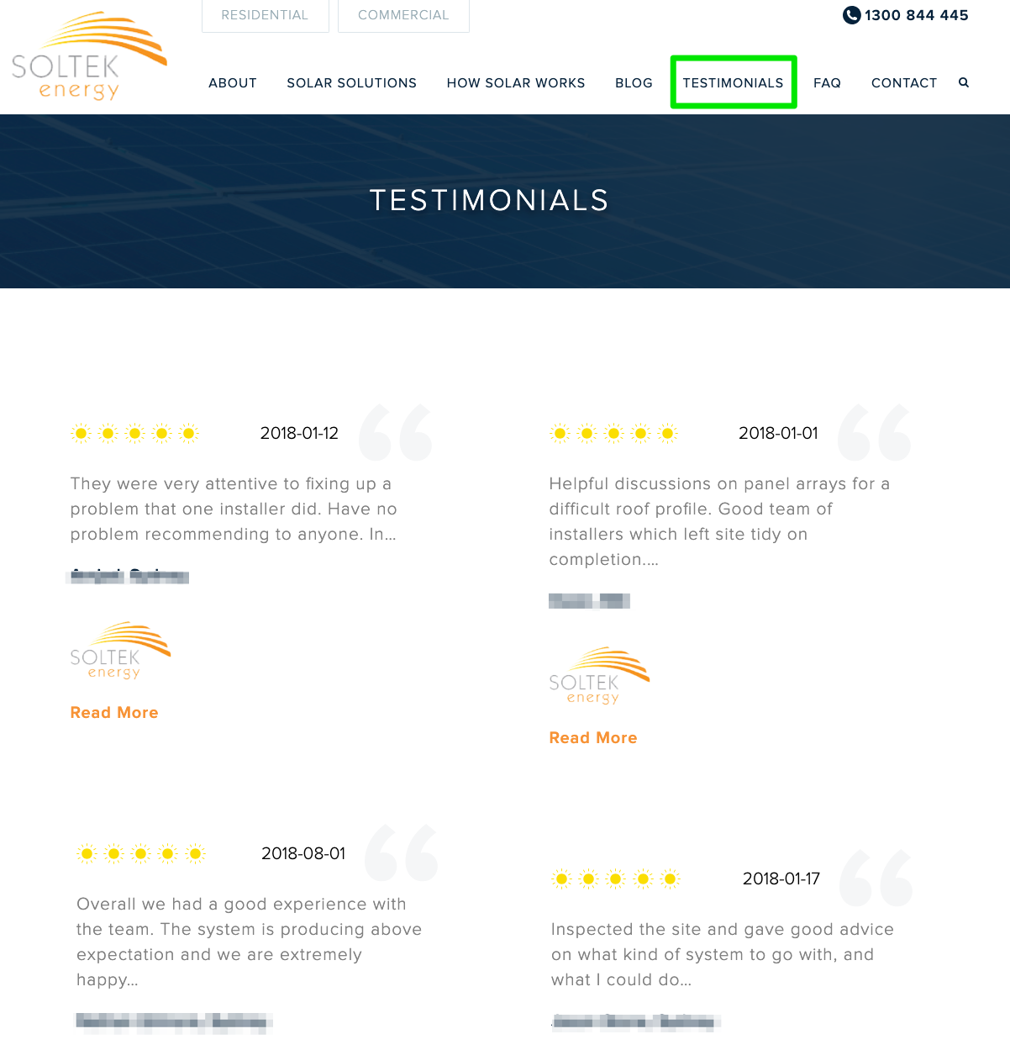
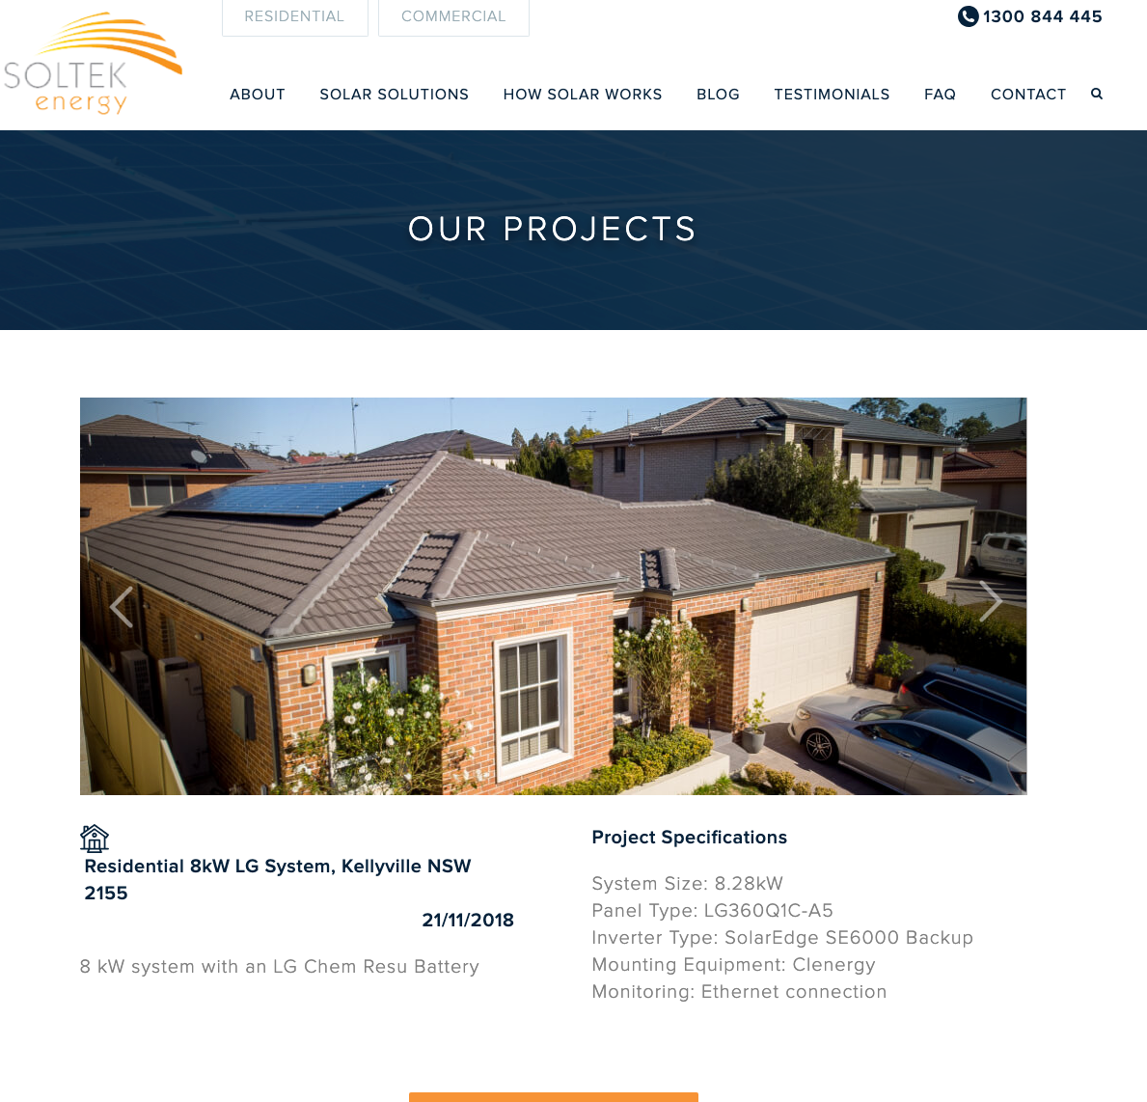
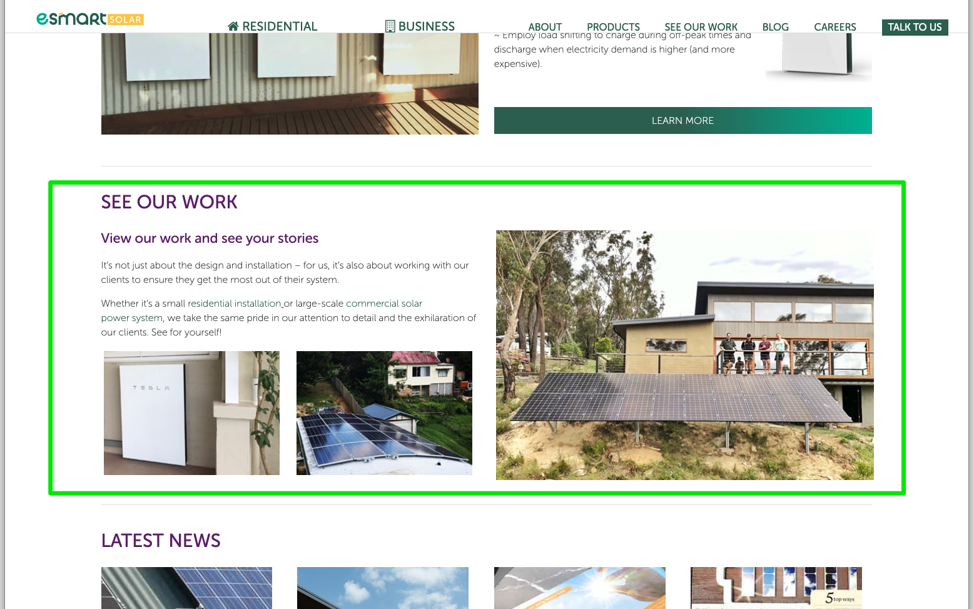
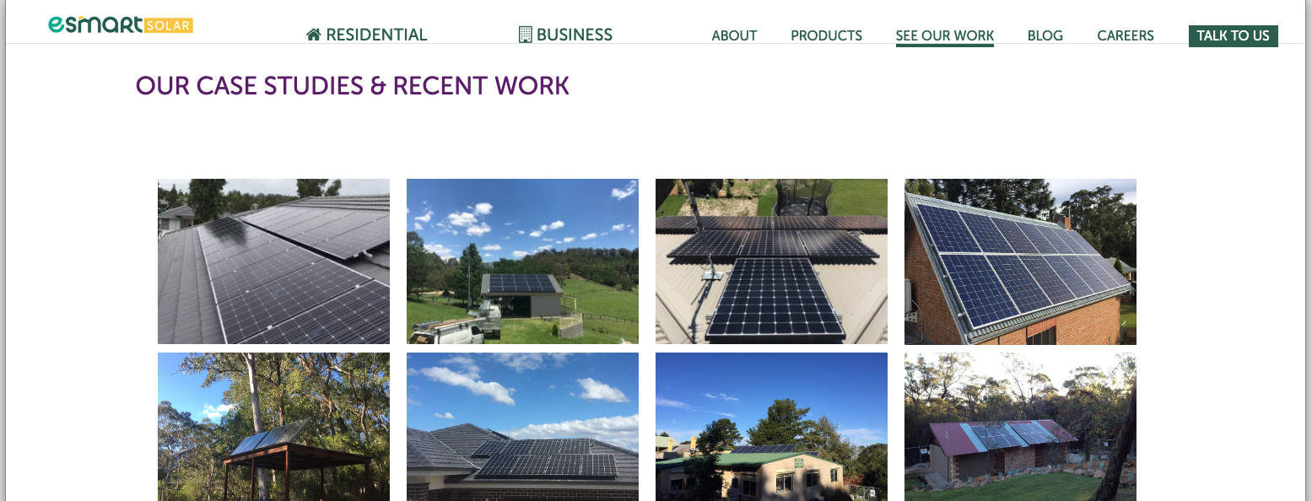

Slide 20
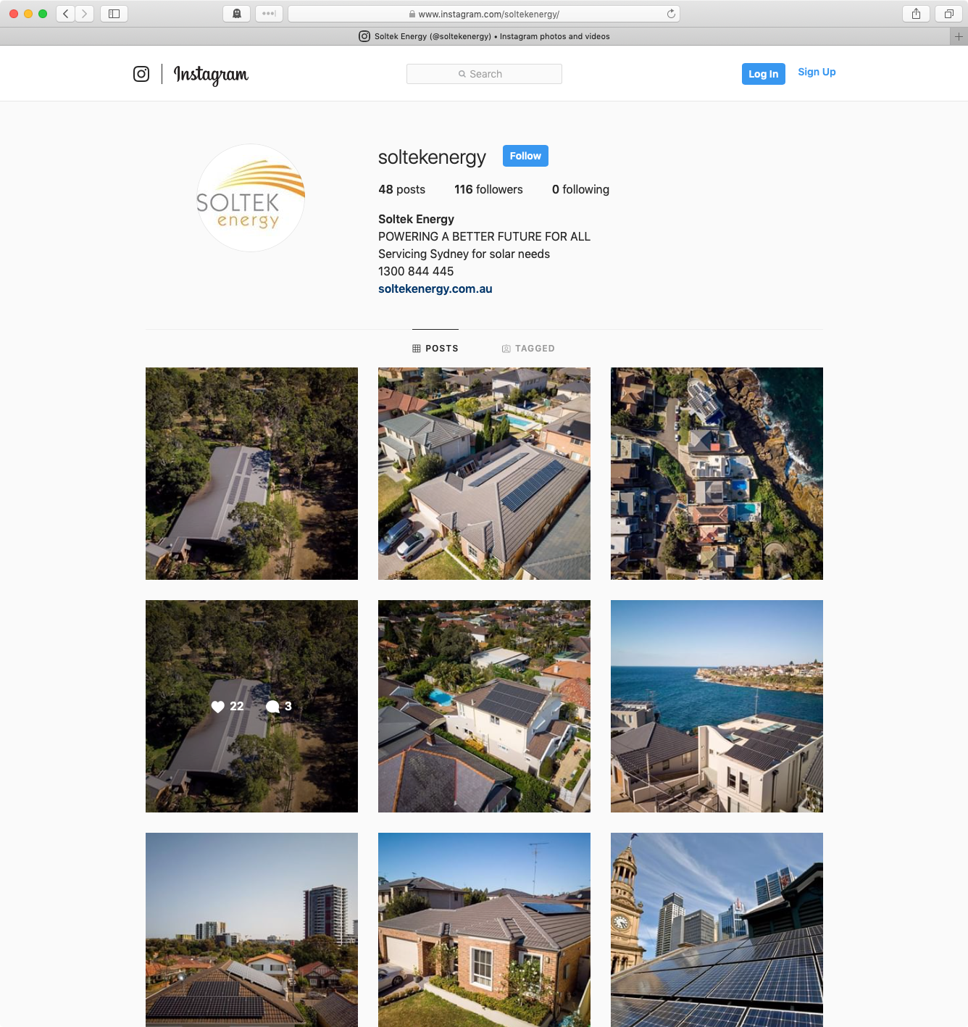
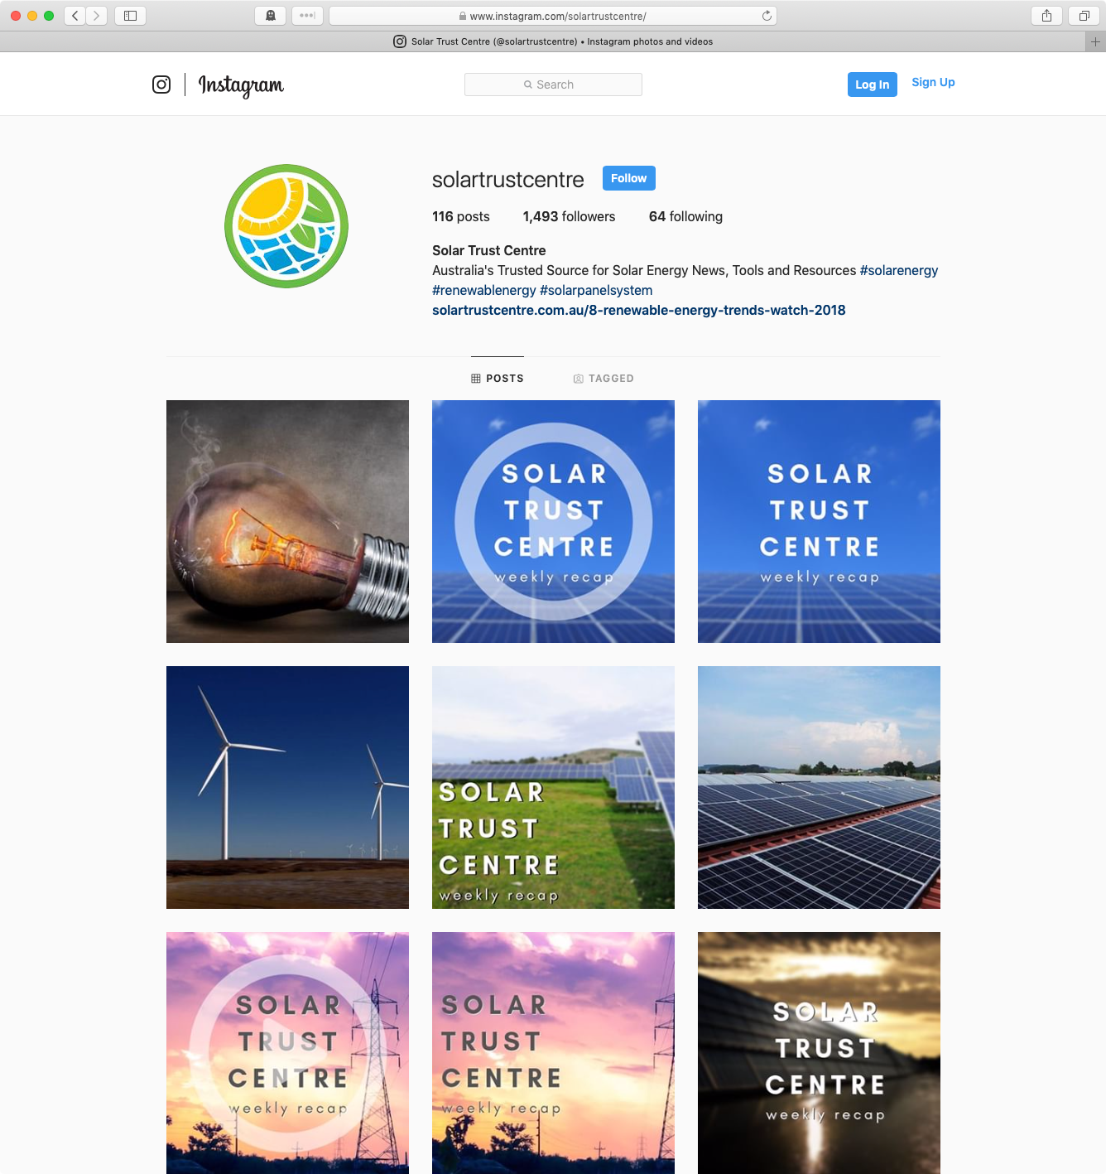

Slide 21

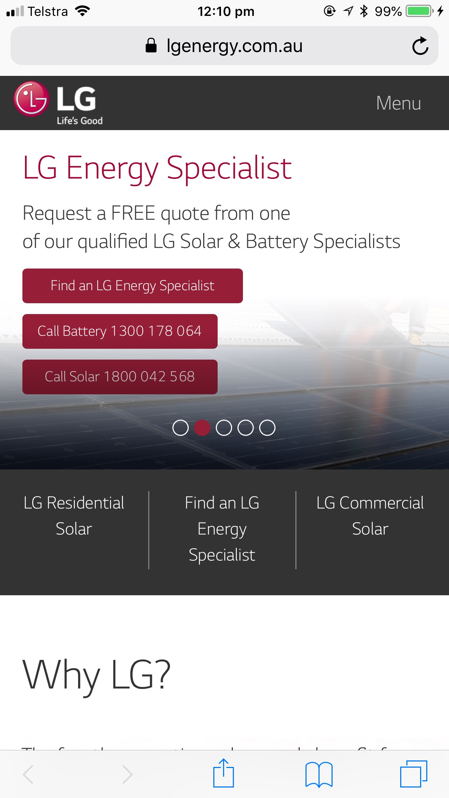
45% of LG Traffic in 2018 was on mobile
Mobile Friendly
Your site must work well on mobile phones
⇒ Plan with your web developer if needed
People research with their phones in spare moments (‘micro moments’)
Google is rewarding sites that work well on mobile, and demoting sites that don’t...
Notes:
Replace image placeholder: Click on the image -> Click on ‘Replace image’ -> Choose your image.

Slide 22
Second, let’s talk about how lead generation is changing

Slide 23
Lead Generation
Key items to put in place
People are pulling back
Contact leads proactively
Provide help first, sell second
Keep them engaged and educated with continual follow ups (more emails, calls)
Phone calls: “How did you hear about us?”
Call tracking
Notes:
Replace image placeholder: Click on the image -> Click on ‘Replace image’ -> Choose your image.

Slide 24
Call all leads right away (eg within a day)
Provide help first,
Sell second

Slide 25
Ask callers how they found you.
Use these insights to guide your spend.

Slide 26

SUMMARY
Notes:
Send Background to back: Right click on the image -> Order -> Bring to Back
Replace image placeholder: Click on the image -> Click on ‘Replace image’ -> Choose your image.
Send image placeholder to back: Right click on the image -> Order -> Bring to Back

Slide 27

Summary
So Far
Digital Marketing
There are challenges to face
There are opportunities to improve
Credibility: website and social
Lead Generation: more proactive
Notes:
Replace image placeholder: Click on the image -> Click on ‘Replace image’ -> Choose your image.

Slide 28
Solar Action Items
Credibility:
Ask customers for reviews on Google and Facebook
Use Instagram for showcasing installs and quality
Highlight installs (image and video) on your site and Facebook
Highlight your time in business - quality and reliability
Mobile friendly site
Fast site

Slide 29
Solar Action Items
Lead Generation:
Ask customers how they found you - especially when they call
Call all leads (including ebook downloaders) right away, but…
Be helpful first, sell second

Slide 30
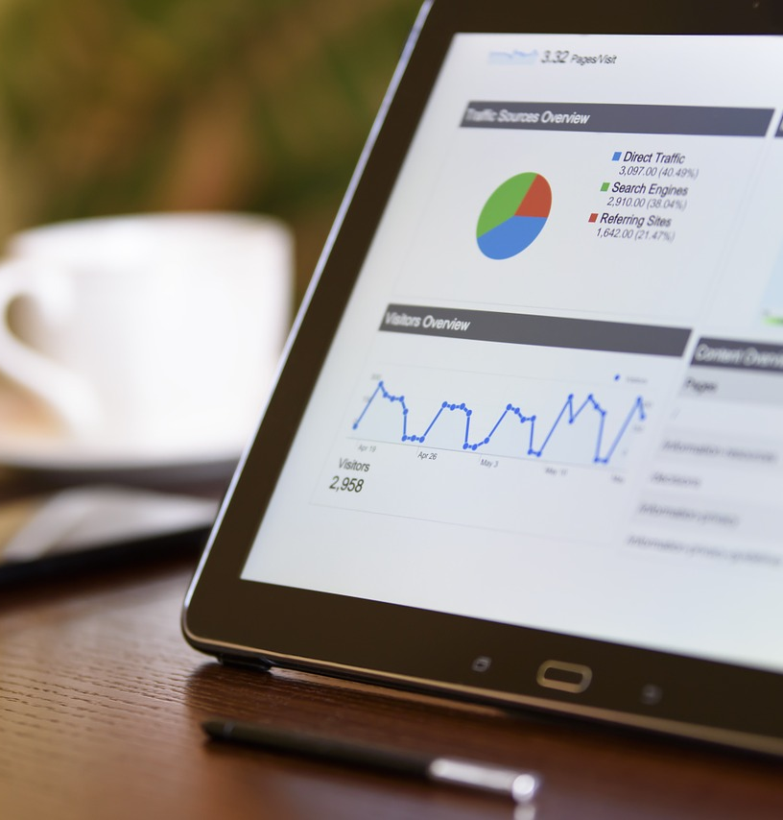
Chat with us
Sydney based agency, with staff in Sydney and Newcastle
+61 (02) 8006 4428
+61 (0) 413 489 388
www.xensolar.com.au
xen.com.au
craig@xen.com.au
craig@xensolar.com.au
Notes:
Replace image placeholder: Click on the image -> Click on ‘Replace image’ -> Choose your image.

Slide 31
How can we help you?
(We’re interested to know what you are struggling with)

Slide 32
www.xensolar.com.au/lg-dealers

